Slide 1

Restaurant Management System
Hang Xia

Slide 2

1
About the topic
Database purpose
Restaurant
Management
System
2
Design
Database design, ERD
3
Code
Table, Function,Encyption
4
Data analysis
View, Reports

Slide 3



Database purpose
The purpose of this database system is to provide restaurant manager an easy and quick way to manage the restaurant.
This database collects and stores restaurant information, customer information, order information, table information, staff information, delivery information in order to manage, query, display and output records, and ensure the operation of daily affairs of the restaurant effectively.
In addition, our system ensure the linkage of entities and smooth operation during normal work. Whole system guarantee the accuracy between restaurant and customer and keep a low error rate.

Slide 4
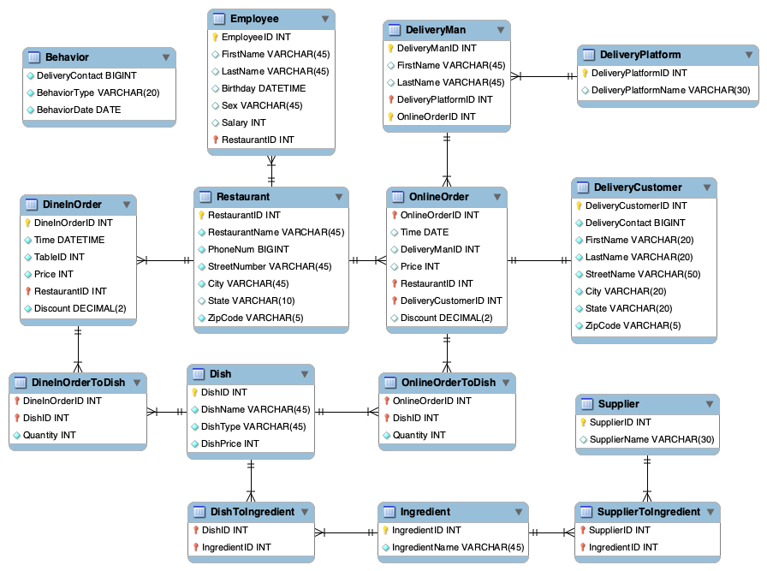
Entity
Relationship
Diagram

Slide 5
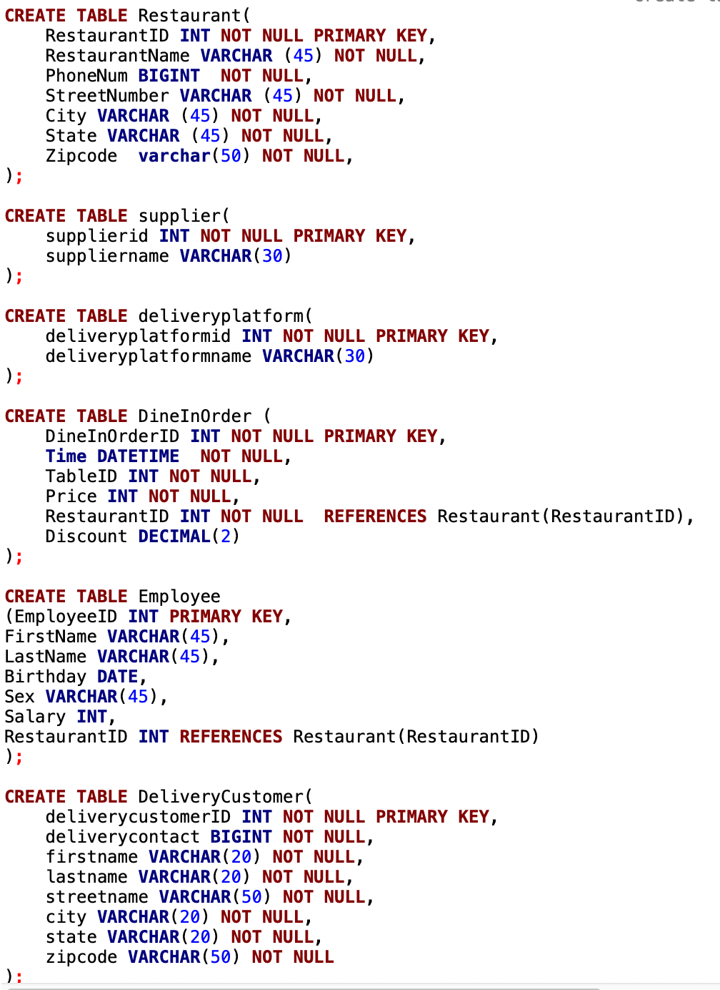
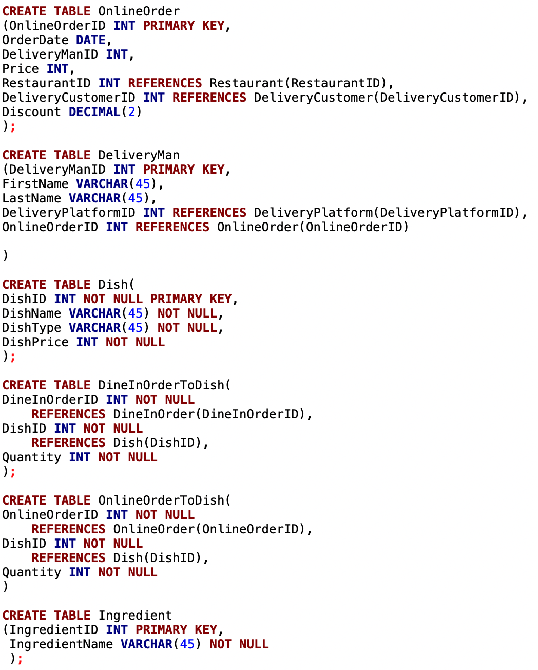
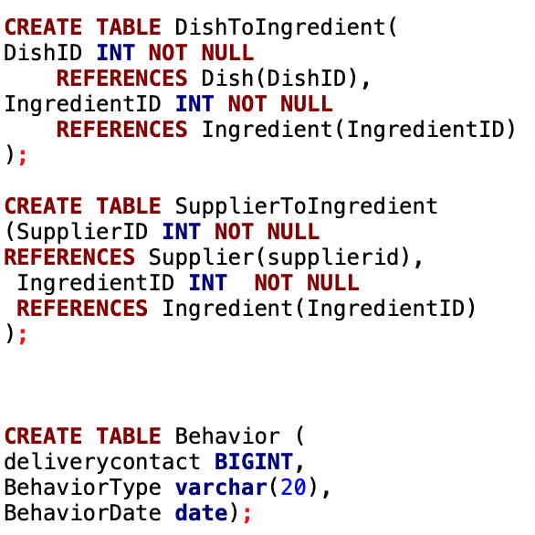

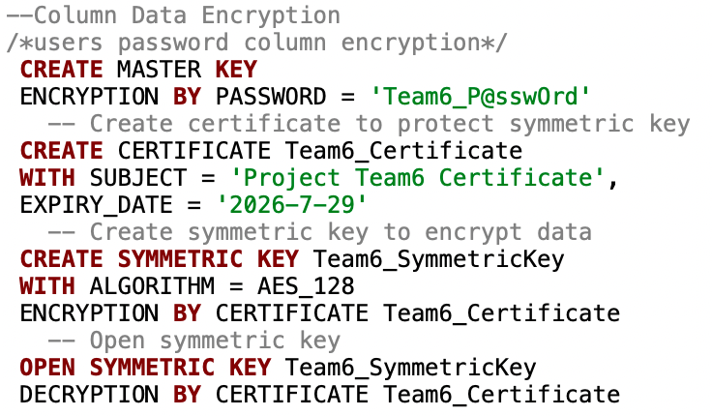
DDL and Data Insertion
请替换文字内容，修改文字内容，也可以直接复制你的内容到此。请替换文字内容，修改文字内容，也可以直接复制你的内容到此。请替换文字内容，修改文字内容，也可以直接复制你的内容到此。
点击添加标题
请替换文字内容，修改文字内容，也可以直接复制你的内容到此。请替换文字内容，修改文字内容，也可以直接复制你的内容到此。请替换文字内容，修改文字内容，也可以直接复制你的内容到此。

Slide 6
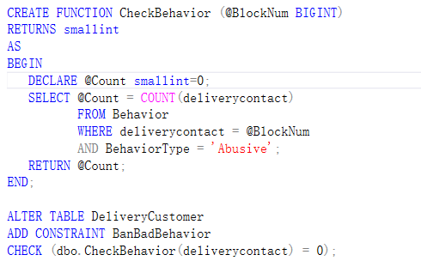
Table-Level
Constraint
Computed Columns based on a function
function
Create a function to check whether a customer has ever had abusive behavior
result
A warning message will occur

Slide 7
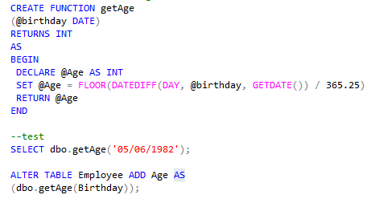
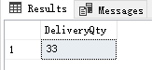
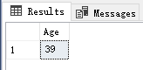
Function
Computed Columns based on a function
function
Get age based on birthday
result
Enter birthday “ 05/16/1982” to get age “39”

Slide 8
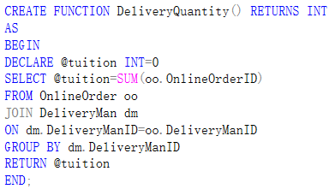
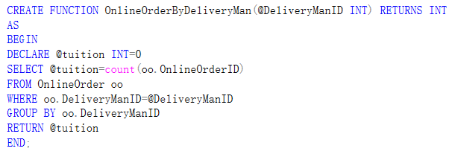
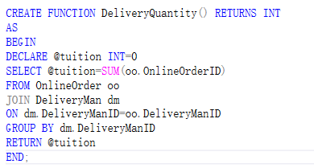
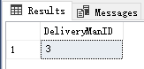
Function
Computed Columns based on a function
function
Get total order quantity deliveryman transports
result
the result of total order quantity deliveryman transports is 33

Slide 9
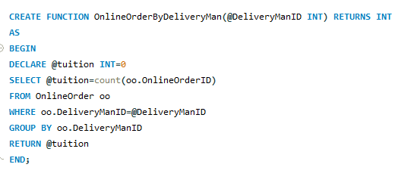
Function
Computed Columns based on a function
function
Enter DeliveryManID to get the order quantity he transports
result
Enter DeliveryManID “1” to get the order quantity “3”

Slide 10
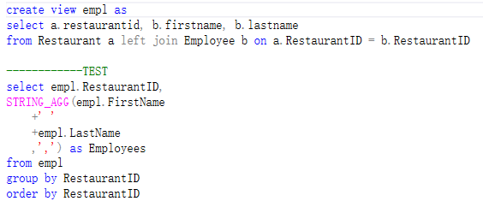
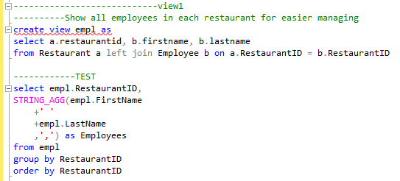
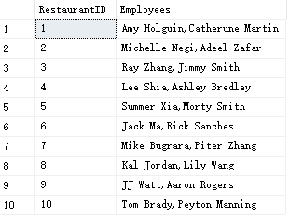
View 1
This view was created to display every employee in every restaurant. It can provide an easier employee management.

Slide 11
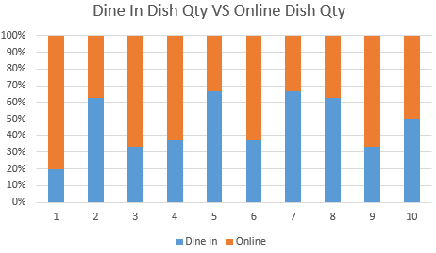
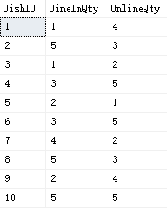
Report 1
This report displays the quantity comparison of the same dishes among Online Orders and Offline Orders.

Slide 12
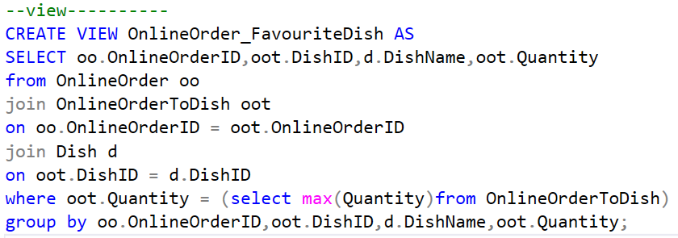
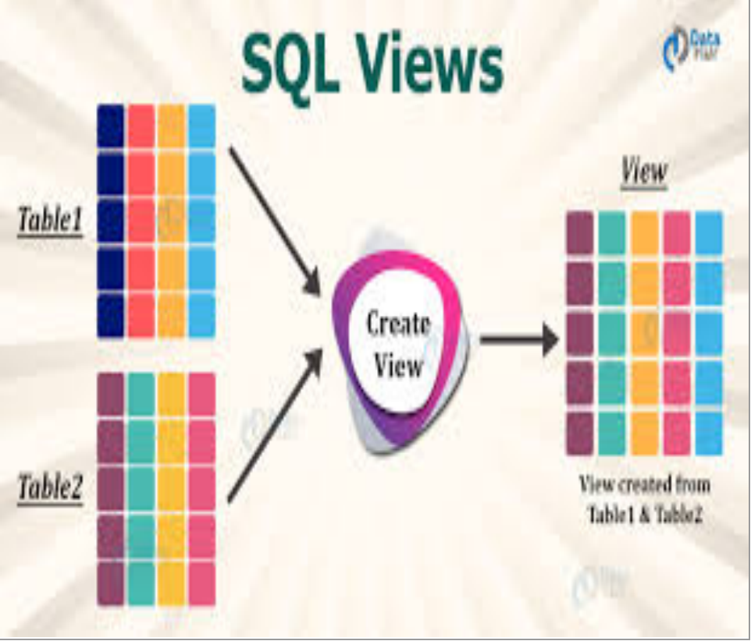

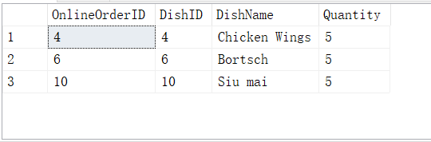

View 2
点击添加标题
请替换文字内容，修改文字内容，也可以直接复制你的内容到此。
点击添加标题
This view was created to show the favourite food for online customers

Slide 13
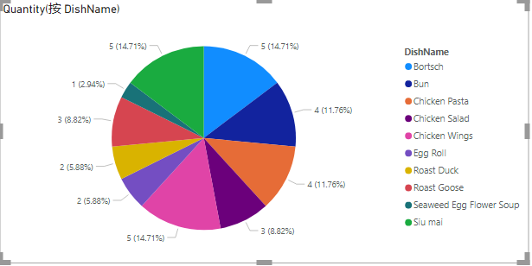
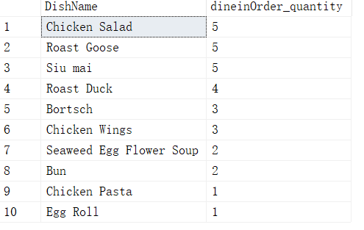
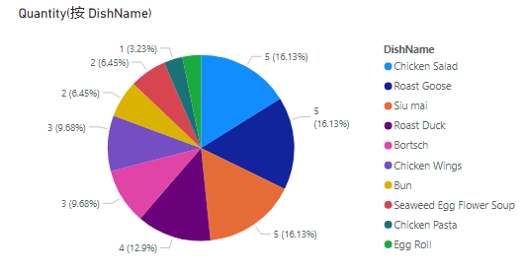
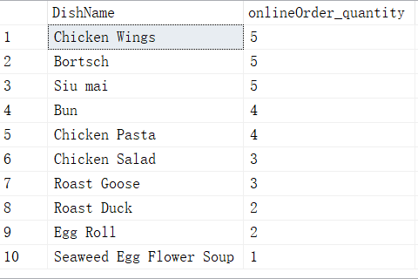
Report 2
This report displays the most popular dish in the DineInOrder and the most popular dish in the OnlineOrder

Slide 14
THANK YOU

